Slide 1
Marketing Email Campaign
&
Subscription Retention Rate Analysis
Dr. Shih Yu Chang
Team 6:
Poojitha Amin
Charu Ramnani
Prajwal Venkatesh
Preksha Pansheriya
Yogeswara Sarat Bankapalli
Praneeth Varma Alluri

Slide 2

Marketing Email Campaign
Problem Statement
ML Driven marketing optimization.
Dimensions of optimization:
Audience attributes
Offer attributes
Tactic attributes
Email campaign metrics to track.
Digital marketing as a recommendation system problem.

Slide 3
Datasets and Description
Dataset 1 : email_table (100000 records), email_opened_table (10345 records), link_clicked_table(2119 records).
Features: email_id, email_text, email_version, hour, weekday, user_country, past_purchases
Dataset 2 : SpamClickBait Dataset (3,089,781 records)
Features: headline_text: Text of the headline in English with rare utf8 chars (<1k)
Dataset 3 : Enron dataset - sender and recipient details.

Slide 4
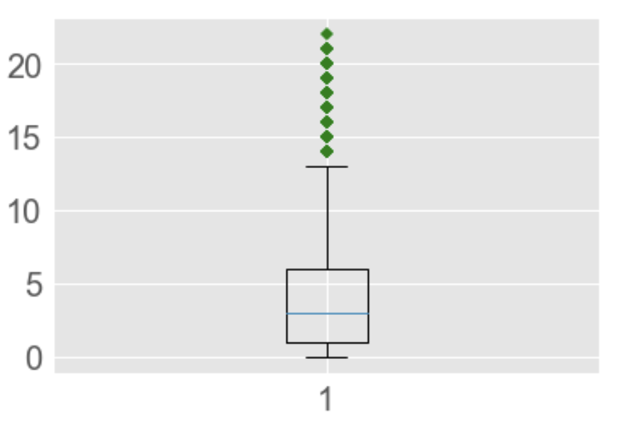
Data Preprocessing
User Purchases Boxplot
Null value check
Remove outliers
Feature engineering by combining tables
Feature selection
One hot encoding
Resampling to handle imbalanced dataset
Standardization to scale the values

Slide 5
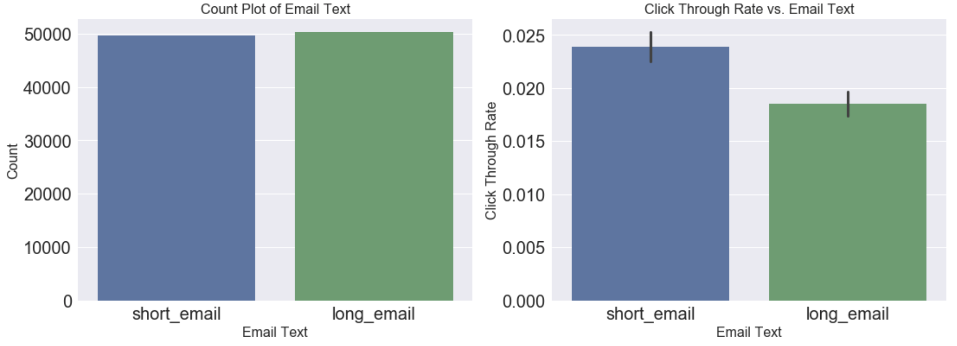
Exploratory Data Analysis
Email Text Visualization

Slide 6
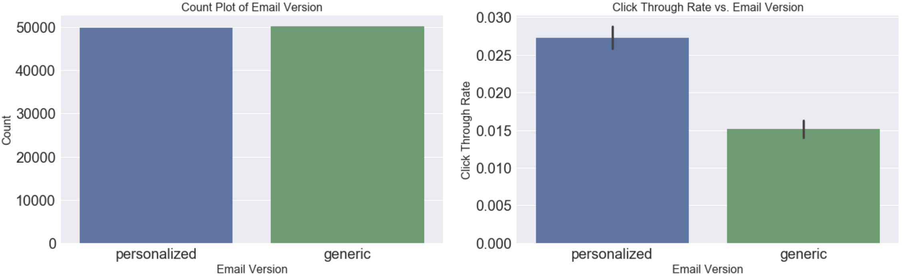
Email Version Visualization

Slide 7
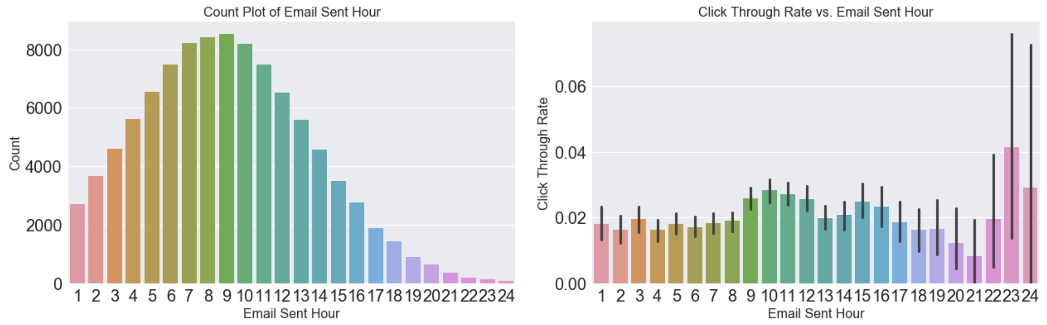
Sent Hour Visualization

Slide 8
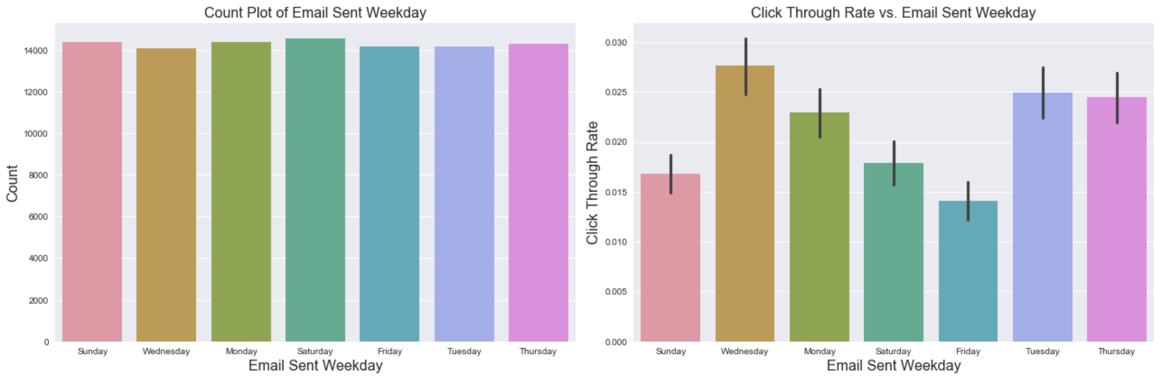
Weekday Visualization

Slide 9
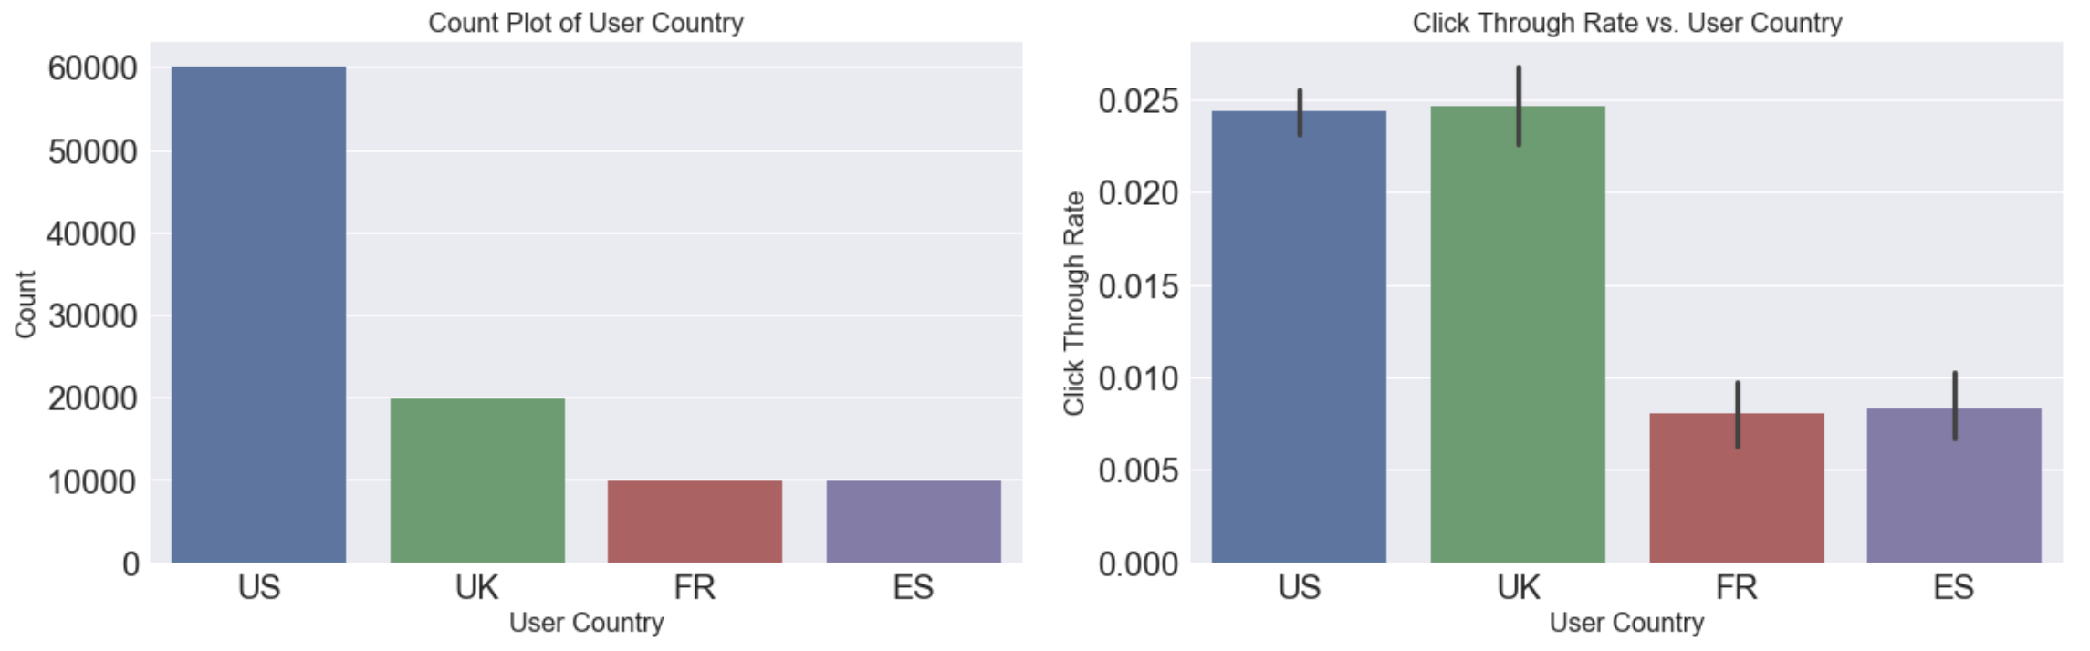
User Country Visualization

Slide 10
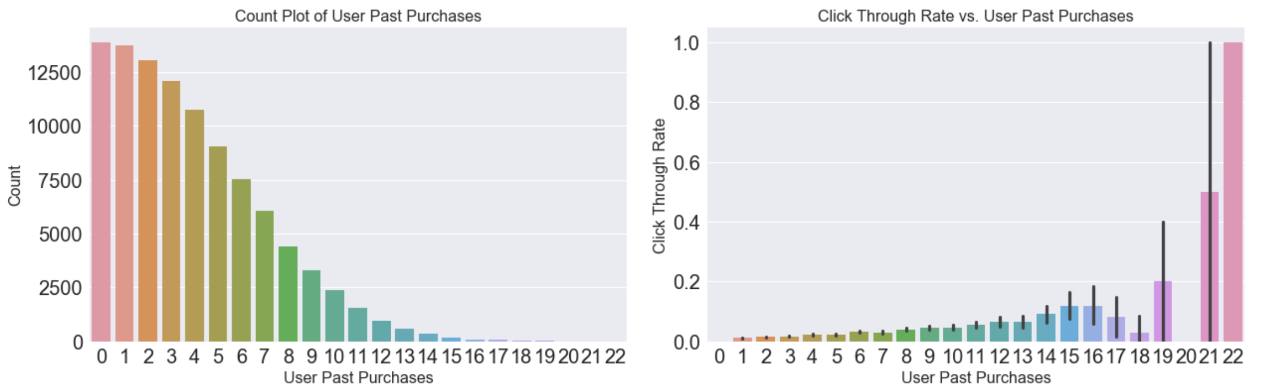
Past Purchases Visualization

Slide 11
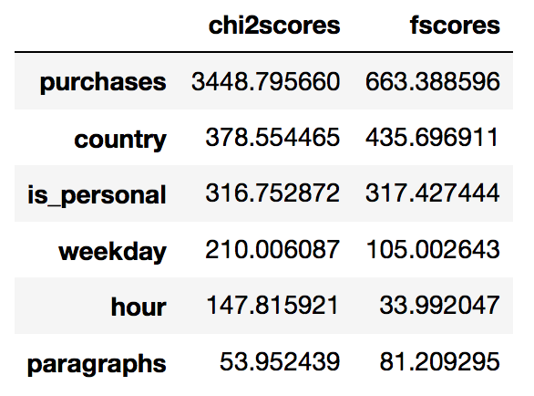
Feature selection using Chi Square Test & F-Test
Important Features
Less Important Features

Slide 12
Model Selection and Reasons
Models selected for experiment:
XGBoost - often effective on a supervised classification problem
Random Forest - often very effective and easily interpretable
Logistic Regression - Simple, Fast
Support Vector Machine - Maximum margin classifier
Parameters for choosing the model:
Whether the model meets the business goals
How much pre processing the model needs
How accurate the model is
How explainable the model is
How fast the model is
How scalable the model is

Slide 13
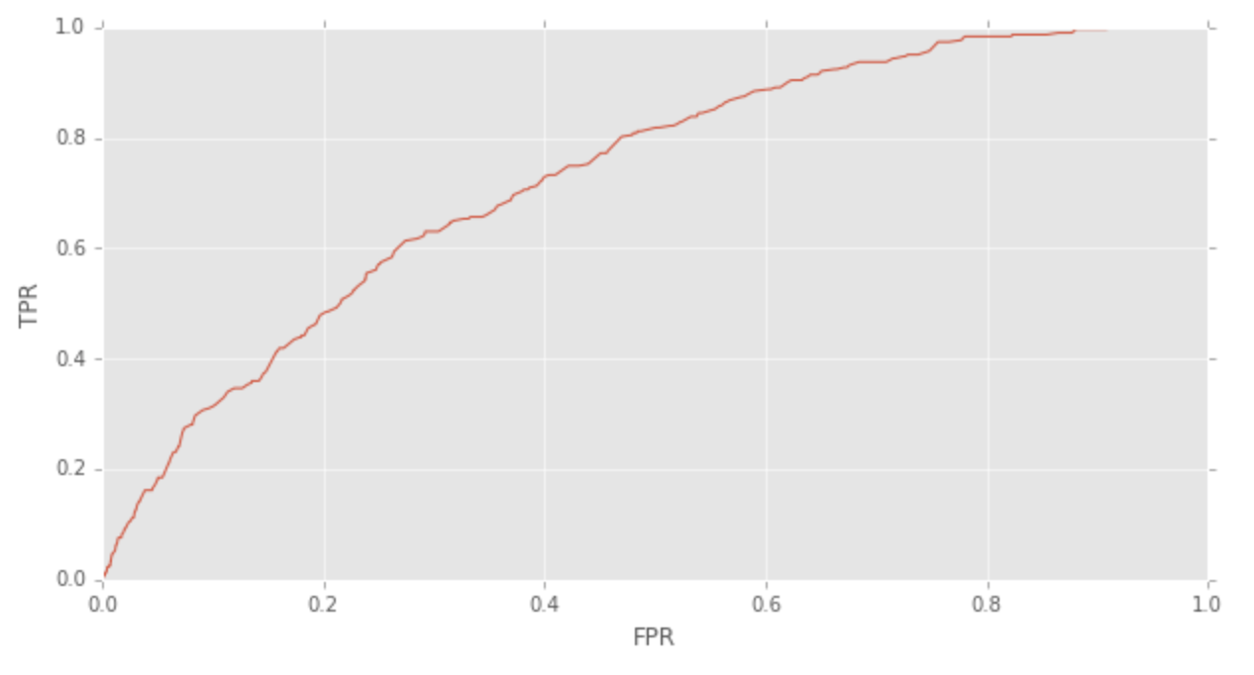
Predictive Models Implementation
XGBoost Model
Gradient Boosted decision trees.
Designed for speed and performance.
Tuned hyper parameters.
Adjusted the threshold value.
ROC curve

Slide 14
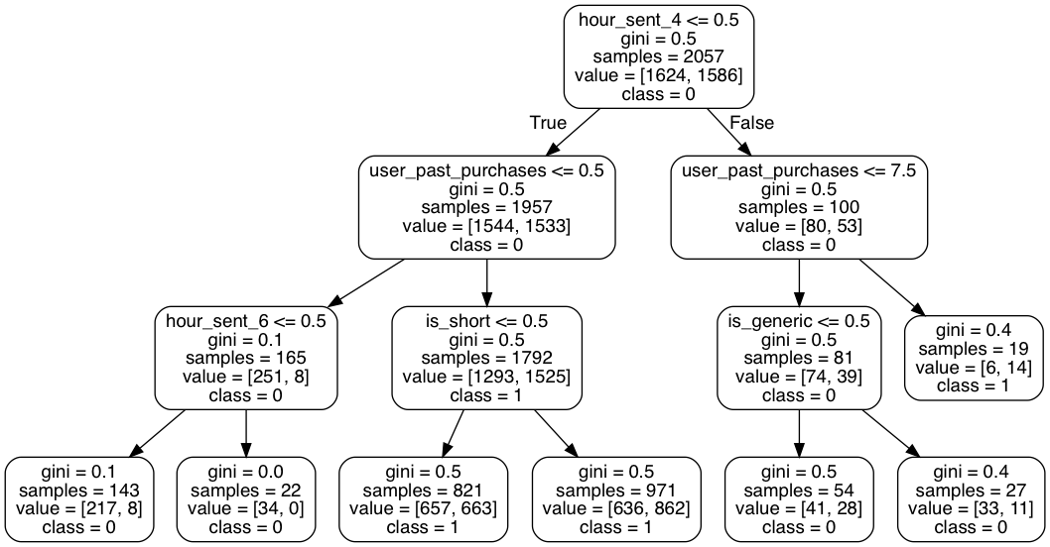
2. Random Forest Model
Root Node
Approached grid search to tune the model.
Tuned the number of trees, max. features to consider, min samples of leaf.
Leaf Nodes

Slide 15
Model Comparison
Model | Recall
XG Boost | 81%
Random Forest | 73%
Logistic Regression | 60%
Support Vector Machine | 64%

Slide 16
Initial Results and Comparison
What percentage of users opened the email and what percentage clicked on the link?
Percent opened 10.345, Percent clicked 2.119.
Build a model to optimize in future email campaigns.
Gradient Boosting Tree model to predict whether a user will click the link or not.
By how much do you think your model would improve click through rate.
emails sent in new way 9904.000000
emails sent in old way 33333.000000
saving percentage (%) 70.287703
Interesting patterns on how the email campaign performed.

Slide 17
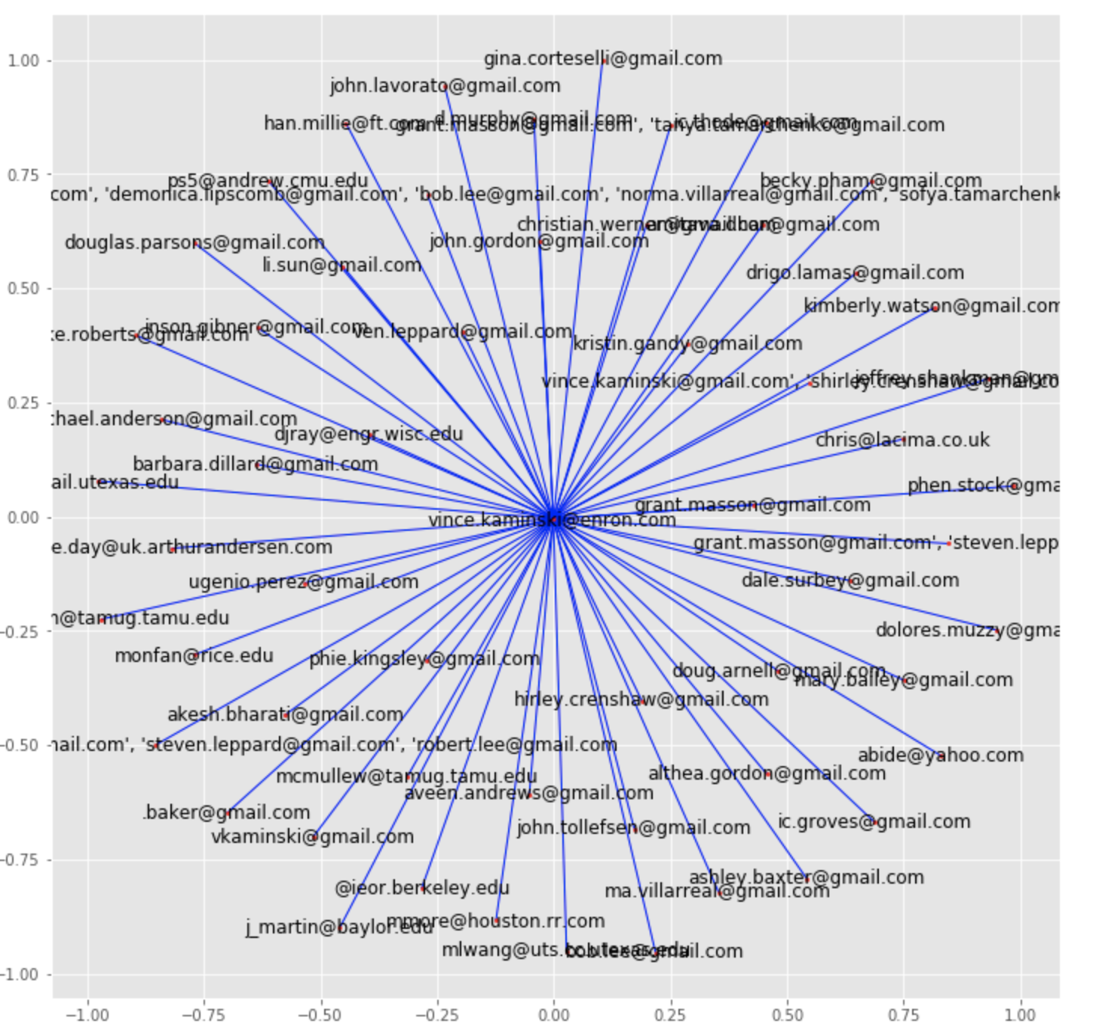
Email Network Analysis
1. Network Plot
Shows dominance of one node.
One sales executive, Mr. Vince Kaminski, is connected to most customers, providing highest click through rate in the promotion emails sent by him.
Can be useful in visually understanding the
number of neighbours and check if a connection exists between an executive and a customer.
Analyse distribution of message spread time if a referral program is introduced.

Slide 18
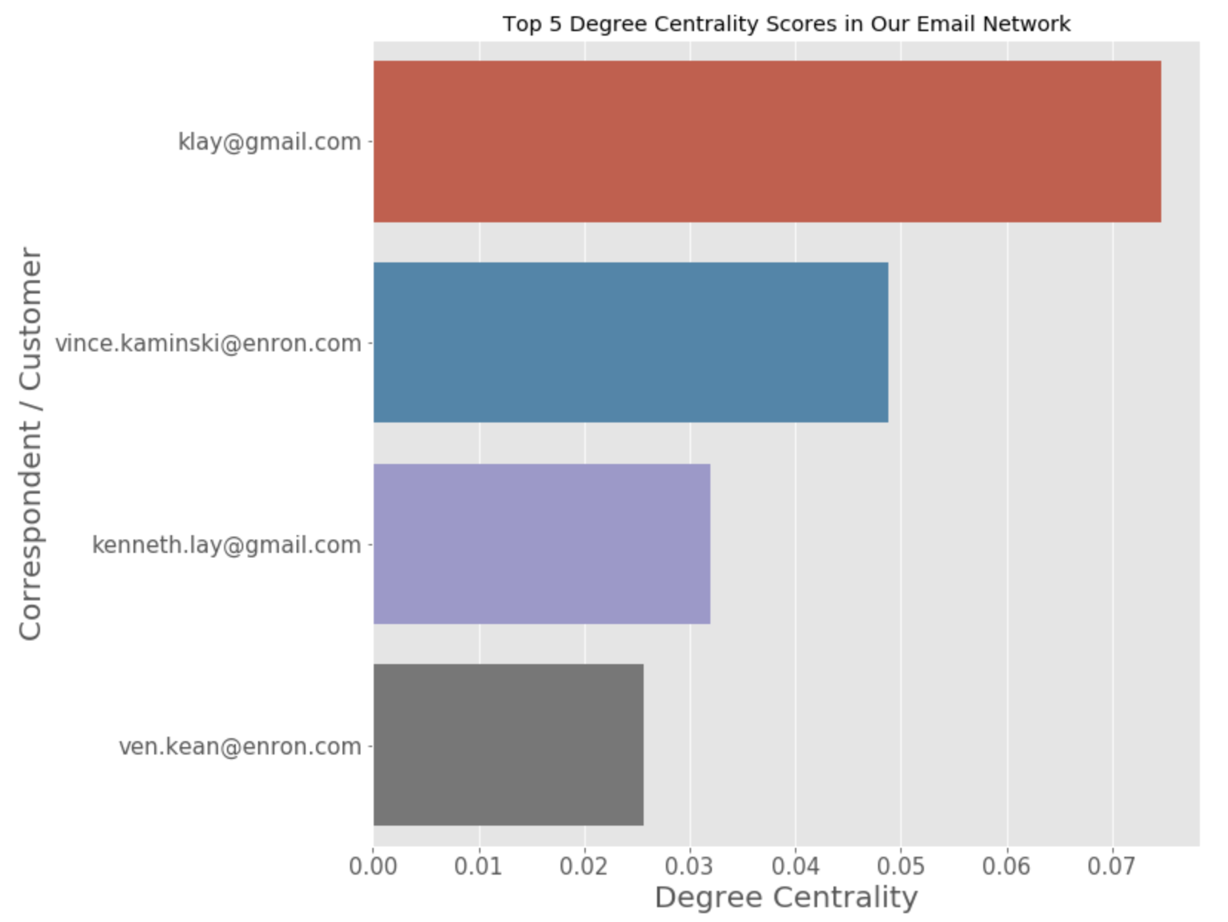
Email Network Analysis Cont’d.
2. Degree Centralities Plot
The degree centrality for a node v is the fraction of nodes it is connected to.
Customer with Email ID klay@gmail.com is most connected to our executives.
Vince Kaminski is the most actively connected company executive.

Slide 19
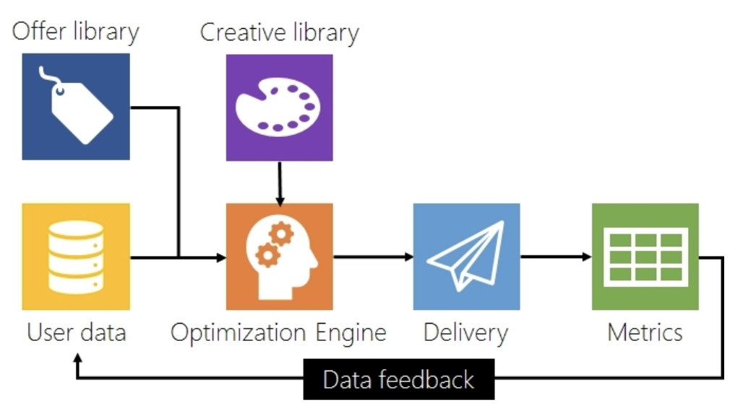
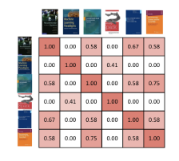
Ideas for Recommendation
Recommendation Engine

Slide 20
Recommendation System Level 1
get_recommendations('Entertainment farewells')
Email Subject Based Recommendation
Implemented a Content Based recommender system using the concept of TF-IDF.
Used to suggest the most similar email subjects.
Steps:
Define a TF-IDF Vectorizer Object.
Removed stop words from email subjects.
Compute the cosine similarity matrix.
Get pairwise similarity scores of all previous email subjects with the new campaign email to be broadcast.
Return the top 10 most similar email subjects sent in the past.
Rank | Email Subject | Similarity Score
1 | Your Entertainment | 0.7560
2 | Weekend Entertainment! | 0.7560
3 | Entertainment For Children | 0.5560
4 | 2010: entertainment lineup | 0.4471
5 | Bowl XLIV Entertainment | 0.4449

Slide 21
Recommendation System Level 2
Item Recommendation
Implemented TensorRec for item based recommendation
TensorRec consumes three types of data:item features,user features and interactions
Dot product of user and item representation vectors predicts the best recommendation
Compare the score generated to actual interactions between user and items with loss function
TensorRec
User features
Item features

Slide 22
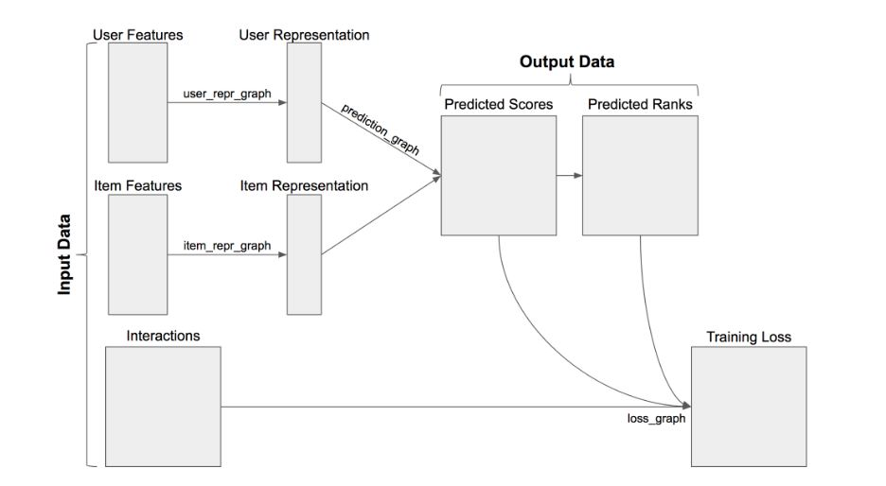
TensorRec Flow Diagram

Slide 23
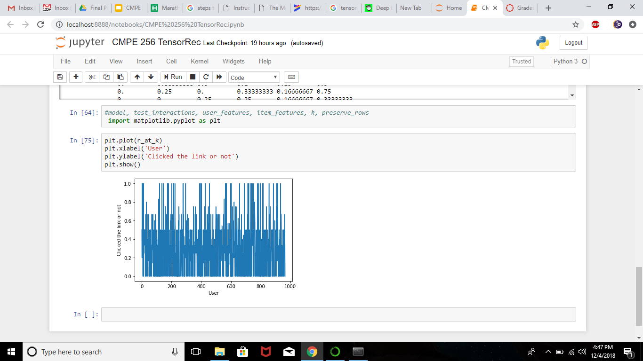
TensorRec Plot for 1000 Users on 50 Items

Slide 24
Summary and Key Success Points
Provided detailed Exploratory Data Analysis.
Explored concrete Data Preprocessing steps.
Built Machine Learning models to classify emails with good accuracy.
Performed Network Analysis on the email dataset.
Built 2 Level Recommendation System to improve the email campaign success rate.
Tensor based recommendation system provided opportunity to work on Deep Neural Network.

Slide 25
Challenges
Email Campaign Dataset availability to suit a machine learning, network analysis and recommendation system based implementation.
Working on Tensorrec to get the recommendations for the users.
Understanding the pattern in user’s response to the emails.

Slide 26
Subscription Retention Rate Analysis
Subscription Retention: The ratio of retained customers to the total number of customers at the start of that period.
Subscription Retention Rate = (E/S)*100
E: Number of customers at the end of a period
S: Total number of customers at the start of that period

Slide 27
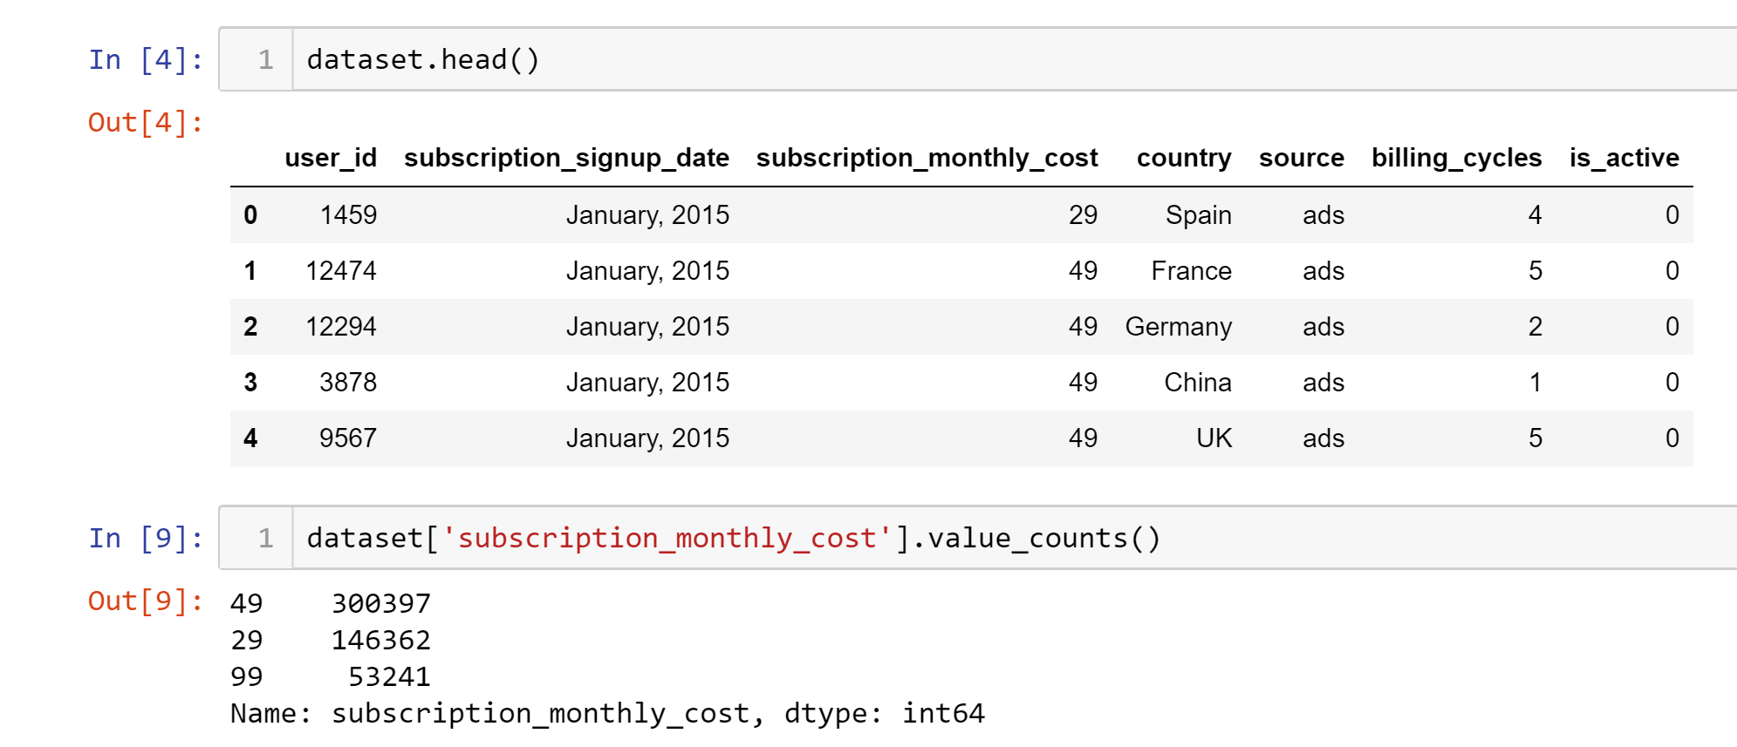
Dataset description
50000 data points
Seven Features
Supervised Learning Dataset
Regression Problem
No missing values and outliers

Slide 28
Problem Statement:
ML based Subscription Business Model.
Calculation of monthly Subscription Retention Rate for different price points.
Prediction of the retention rate after 12 months.
Role of country and source in the improvement of company revenue.

Slide 29
Data Preprocessing
Get the Dataset
Gaining Insights of the dataset (Check for missing values and outliers)
Feature Transformation
Data Visualization

Slide 30
Feature Selection and Transformation
Features are not suitable for solving the problem statement.
Calculation of Subscription Retention Rate for each price point using Billing_Cycles and Is_Active.

Slide 31
Subscription Retention Rate
Months | $29
1 month | 60.75%
2 months | 45.84%
3 months | 37.62%
4 months | 32.30%
5 months | 28.54%
6 months | 25.71%
7 months | 23.59%
Months | $49
1 month | 38.36%
2 months | 20.62%
3 months | 13.40%
4 months | 9.64%
5 months | 7.40%
6 months | 5.94%
7 months | 4.88%
Months | $99
1 month | 15.87%
2 months | 7.00%
3 months | 4.24%
4 months | 2.96%
5 months | 2.21%
6 months | 1.79%
7 months | 1.50%

Slide 32
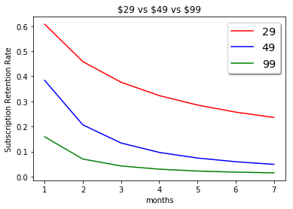
Monthly Retention Rate of different price points

Slide 33
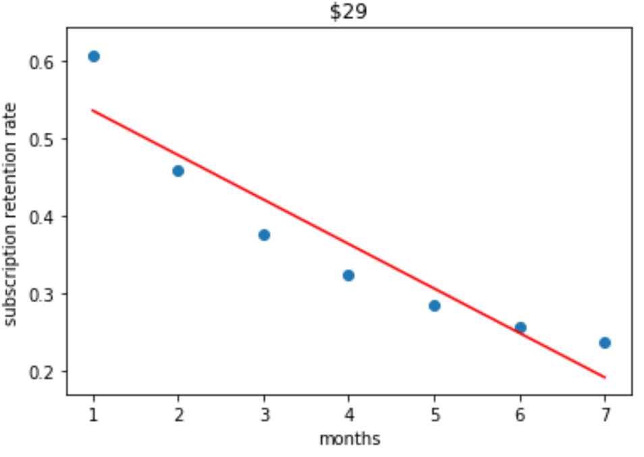
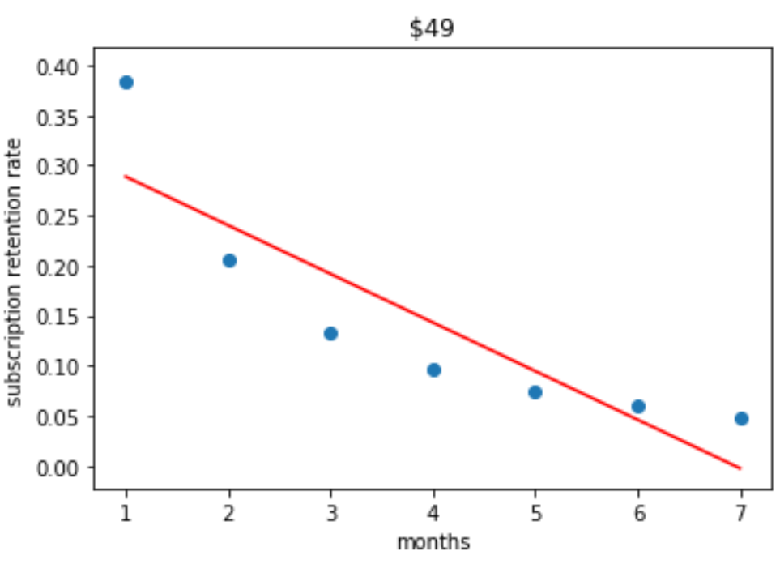
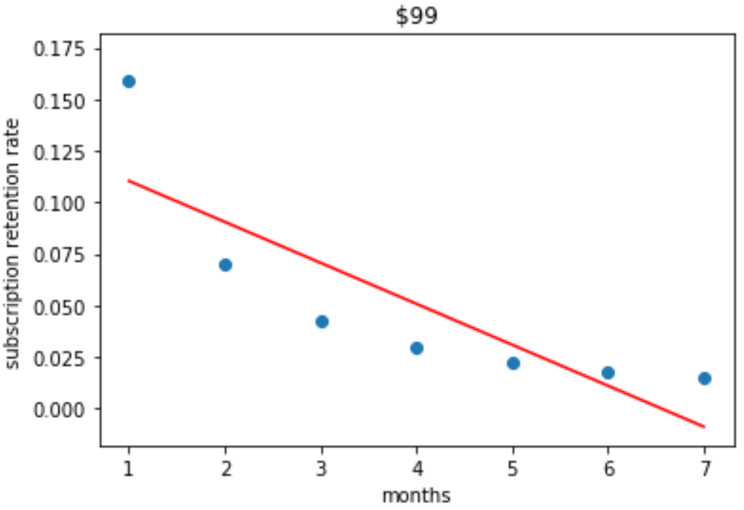
Linear Regression Fit

Slide 34
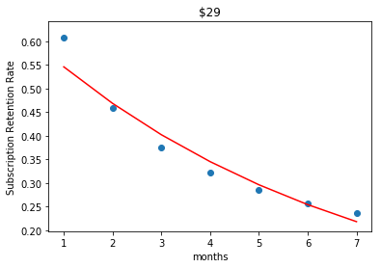
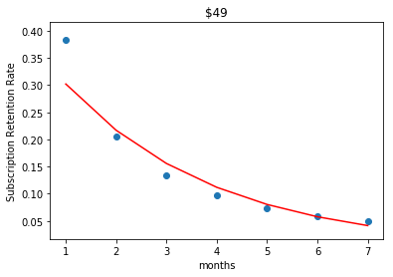
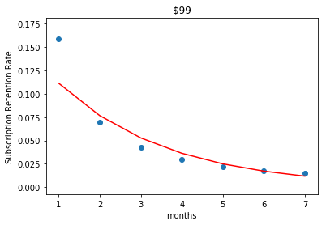
Exponential Regression Fit

Slide 35
RMSE values for Linear Regression and Exponential Regression
Monthly Cost | Linear Regression | Exponential Regression
$29 | 0.04084 | 0.02809
$49 | 0.05195 | 0.03292
$99 | 0.02589 | 0.01877

Slide 36
Predictions based on Exponential Regression
Months | $29 | $49 | $99
After 8 months | 18.76% | 2.97% | 0.81%
After 9 months | 16.10% | 2.13% | 0.56%
After 10 months | 13.83% | 1.53% | 0.38%
After 11 months | 11.87% | 1.10% | 0.26%
After 12 months | 10.19% | 0.79% | 0.18%

Slide 37
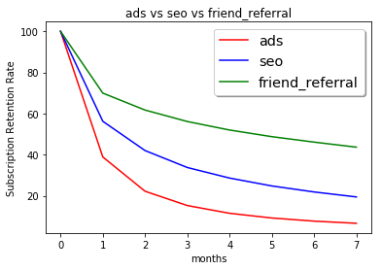
Comparison of Retention Rates of different sources

Slide 38
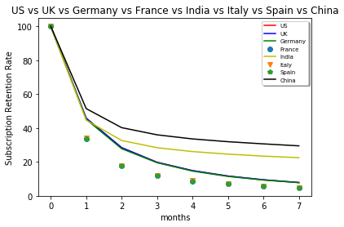
Comparison of Retention Rates of different countries

Slide 39
Business Recommendations
Company should invest less on ads as it has less retention rate.
Company should give special offers to users in India China to encourage more friend referrals which in turn will increase the retention rate

Slide 40
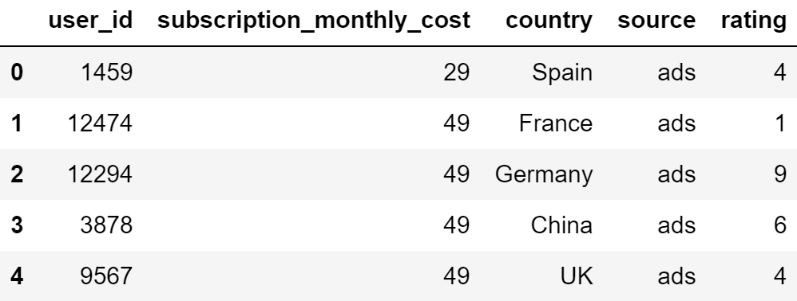
Recommendation Dataset

Slide 41


User Based Collaborative Filtering
US, ads
$29
User 1
$49
7 months
$99
User 2
US, ads

Slide 42
Challenges
The problem statement here is to predict subscription retention rate of monthly costs. However, that particular subscription retention rate class label was not present in the dataset initially.
The dataset is not suitable for creating s recommendation system. Therefore, we had to add new features to the dataset.

Slide 43
Thank You

